Slide 1
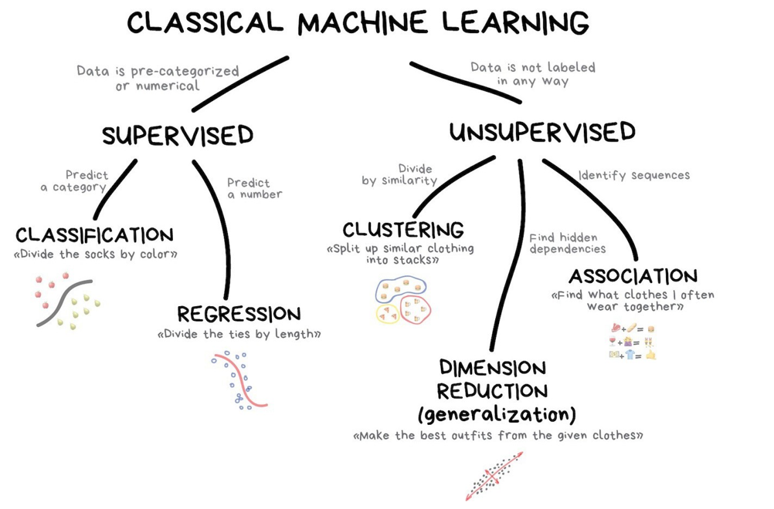
Machine Learning

Slide 2
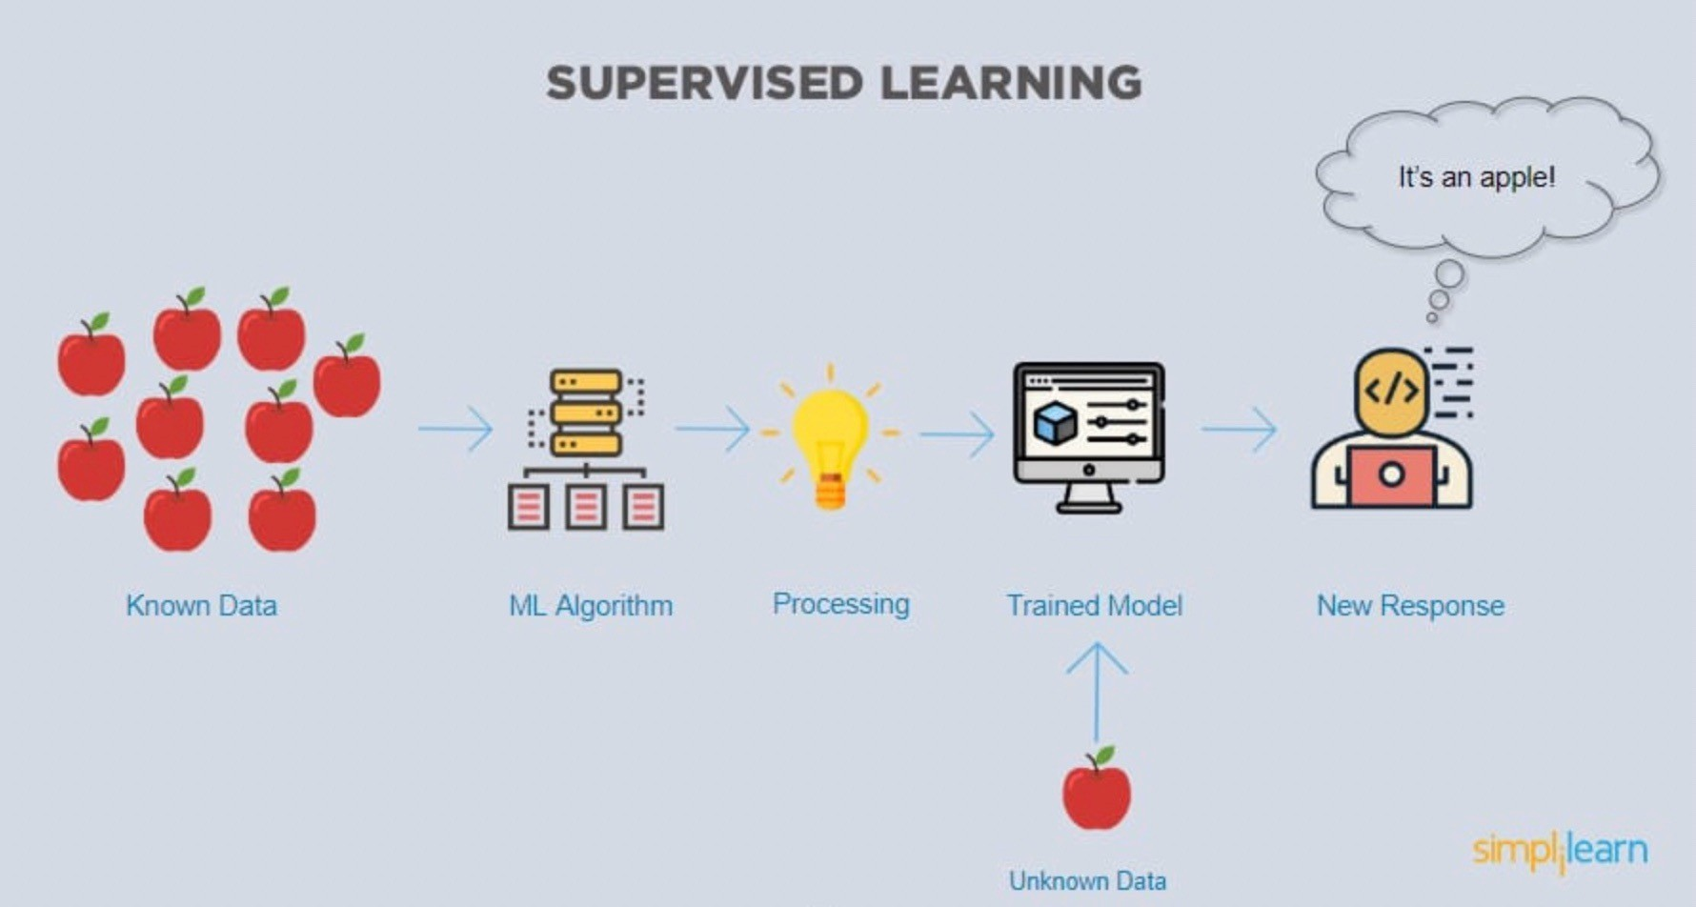
Supervised Learning Algorithms
Supervised Learning: learning to future outcome (Prediction)
  Regression: Linear and Logistic Regression,
  Classification, Decision Tree, Random Forests, SVM, Perceptron, kNN
  Neural Network, Naive Bayes

Slide 3
ML Terms
Example: or observation is a single data item (a particular instance of data or a sample data). This is the input of the system. E.g. an image of an animal. A sample email.
Feature: is an attribute of an example. An example might have many features/dimensions. Examples of features in the spam detector program:
  words in the email text
  sender's address
  time of day the email was sent
  email contains the phrase "one weird trick."

Slide 4
ML Terms
Label: is label is the thing we're predicting. This is the output of the system. E.g. a label “Dog” attached to an example (animal image) specifying that the image shows a dog. Spam vs None-Spam
Labelled Example: is a complete pair of an input and an output (i.e. an example with label or a labelled data items). Content of an email together with its label either ”spam” or “none-spam”
Labelled examples: {features, label}: (x, y)
x={x1,x2,x3,..xn}
Data Set: A data set is a collection of either unlabelled examples or labelled examples.

Slide 5
ML Terms
Training: means creating or learning the model. A data set can be used to train a model.
Model: defines the relationship between features and label. A model can be used to predict labels for unseen data items by running the model.
Training Set: is a fraction of a dataset (generally the major part) which is only used for the purpose of model training.
Test Set: is a fraction of a dataset (generally the minor part) which is only used for the purpose of assessing and evaluating the trained model (e.g. measuring the accuracy of the model).
Inference: means applying the trained model to unlabelled examples

Slide 6
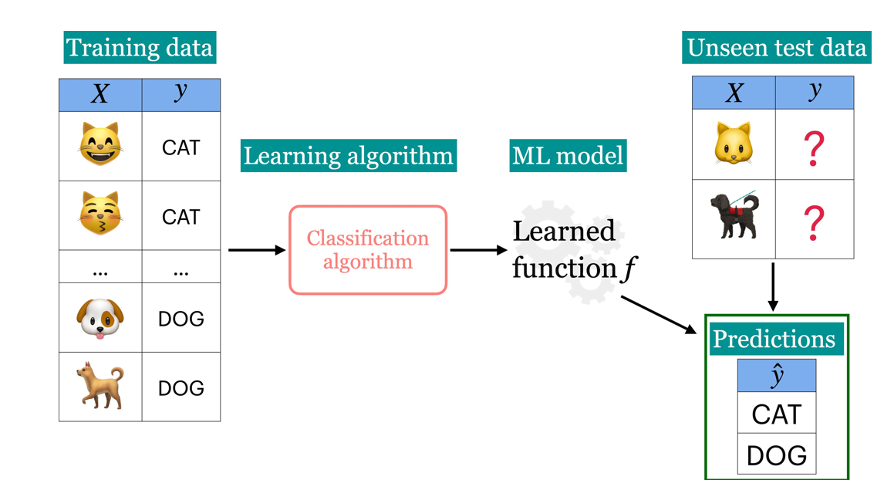
Example:

Slide 7
Reference
https://pytorch.org/tutorials/beginner/blitz/cifar10_tutorial.html
https://learn.microsoft.com/en-us/dotnet/machine- learning/tutorials/object-detection-model-builder
https://machinelearningmastery.com/how-to-develop-a- convolutional-neural-network-to-classify-photos-of-dogs-and- cats/

