Slide 1
Introduction to Machine Learning
Machine Learning, represents a subset of artificial intelligence (AI) dedicated to the refinement of computer algorithms, enabling automatic enhancement through experience and data utilization. In essence, machine learning empowers computers to assimilate from data and execute decisions or forecasts without explicit programming.
Fundamentally, machine learning revolves around the conception and implementation of algorithms that facilitate these decisions and predictions. These algorithms are engineered to iteratively refine their performance, augmenting accuracy and efficacy as they ingest additional data.
For example, in image recognition tasks such as identifying cats, explicit instructions delineating feline characteristics are not provided. Instead, a plethora of cat images is supplied to the machine learning algorithm, which discerns prevalent patterns and distinguishing features characteristic of cats. Through iterative exposure to diverse cat images, the algorithm progressively refines its proficiency in cat identification, transcending to recognize felines in previously unseen images.

Slide 2
Computer systems can be differentiated on the basis of rationality and thinking vs. acting:
Human approach:
Systems that think like humans
Systems that act like humans Ideal approach:
Systems that think rationally
Systems that act rationally
Further Reading material
Oracle
Artificial Intelligence: A Modern Approach

Slide 3
AI Terms
ALGORITHM A set of step-by- step instructions. Computer algorithms can be simple (if it’s 3 p.m., send a reminder) or complex (identify pedestrians). | BACKPROPAGATION The way many neural nets learn. They find the difference between their output and the desired output, then adjust the calculations in reverse order of execution. | BLACK BOX A description of some deep learning systems. They take an input and provide an output, but the calculations that occur in between are not easy for humans to interpret. | DEEP LEARNING How a neural network with multiple layers becomes sensitive to progressively more abstract patterns. In parsing a photo, layers might respond first to edges, then paws, then dogs.
 |  |  | NEURAL NETWORK A highly abstracted and simplified model of the human brain used in machine learning. A set of units receives pieces of an input (pixels in a photo, say), performs simple computations on them, and passes them on to the next layer of units. The final layer represents the answer.
EXPERT SYSTEM A form of AI that attempts to replicate a human’s expertise in an area, such as medical diagnosis. It combines a knowledge base with a set of hand-coded rules for applying that knowledge. Machine- learning techniques are increasingly replacing hand coding.
 | GENERATIVE ADVERSARIAL NETWORKS A pair of jointly trained neural networks that generates realistic new data and improves through competition. One net creates new examples (fake Picassos, say) as the other tries to detect the fakes.
 |  | MACHINE LEARNING The use of algorithms that find patterns in data without explicit instruction. A system might learn how to associate features of inputs such as images with outputs such as labels.
Source: : https://www.sciencemag.org/news/2017/07/ai-revolution-science

Slide 4
AI Terms
TRANSFER LEARNING A
technique in machine
learning in which an algorithm learns to perform one task, such as recognizing cars, and builds on that knowledge when learning a different but related task, such as recognizing cats.
TENSORFLOW A collection of software tools developed by Google for use in deep learning. It is open source, meaning anyone can use or improve it. Similar projects include Torch and Theano.
SUPERVISED LEARNING A
type of machine learning in which the algorithm
compares its outputs with the correct outputs during
training. In unsupervised learning, the algorithm
merely looks for patterns in a
set of data.
PERCEPTRON An early type of neural network, developed in the 1950s. It received great hype but was then shown to have limitations, suppressing interest in neural nets for years.
TURING TEST A test of AI’s ability to pass as human. In Alan Turing’s original conception, an AI would be judged by its ability to converse through written text.
REINFORCEMENT
LEARNING A type of machine
learning in which the algorithm learns by acting toward an abstract goal, such as “earn a high video game score” or “manage a factory efficiently.” During training, each effort is evaluated based on its contribution toward the goal.
NATURAL LANGUAGE
PROCESSING A computer’s
attempt to “understand” spoken or written language. It must parse vocabulary, grammar, and intent, and allow for variation in language use. The process often involves machine learning.
STRONG AI AI that is as smart and well-rounded as a human. Some say it’s impossible. Current AI is weak, or narrow. It can play chess or drive but not both, and lacks common sense.
NEUROMORPHIC CHIP A
computer chip designed to act as a neural network. It
can be analogue, digital, or a combination.
Source: : https://www.sciencemag.org/news/2017/07/ai-revolution-science

Slide 5
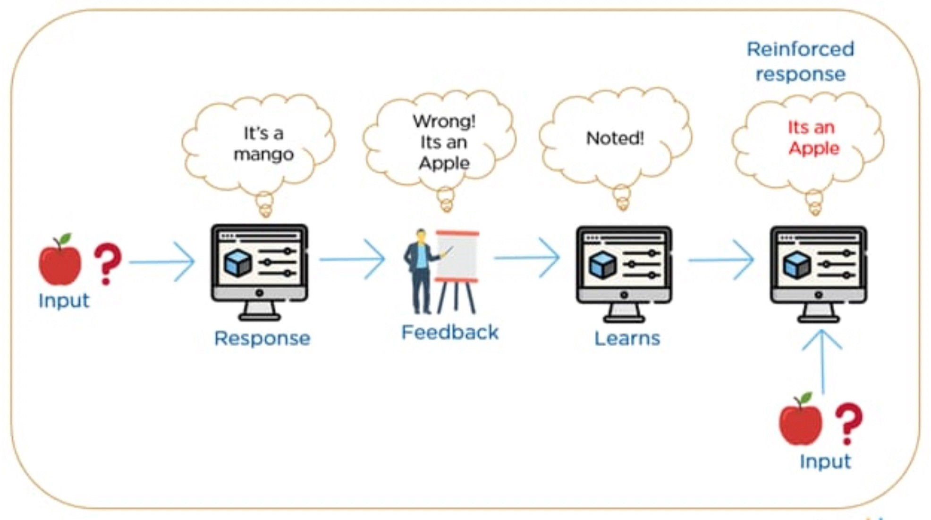
Machine learning
Machine learning is a subset of AI, which uses algorithms that learn from data to make predictions. These predictions can be generated through supervised learning, where algorithms learn patterns from existing data, or unsupervised learning, where they discover general patterns in data. ML models can predict numerical values based on historical data, categorize events as true or false, and cluster data points based on commonalities.

Slide 6
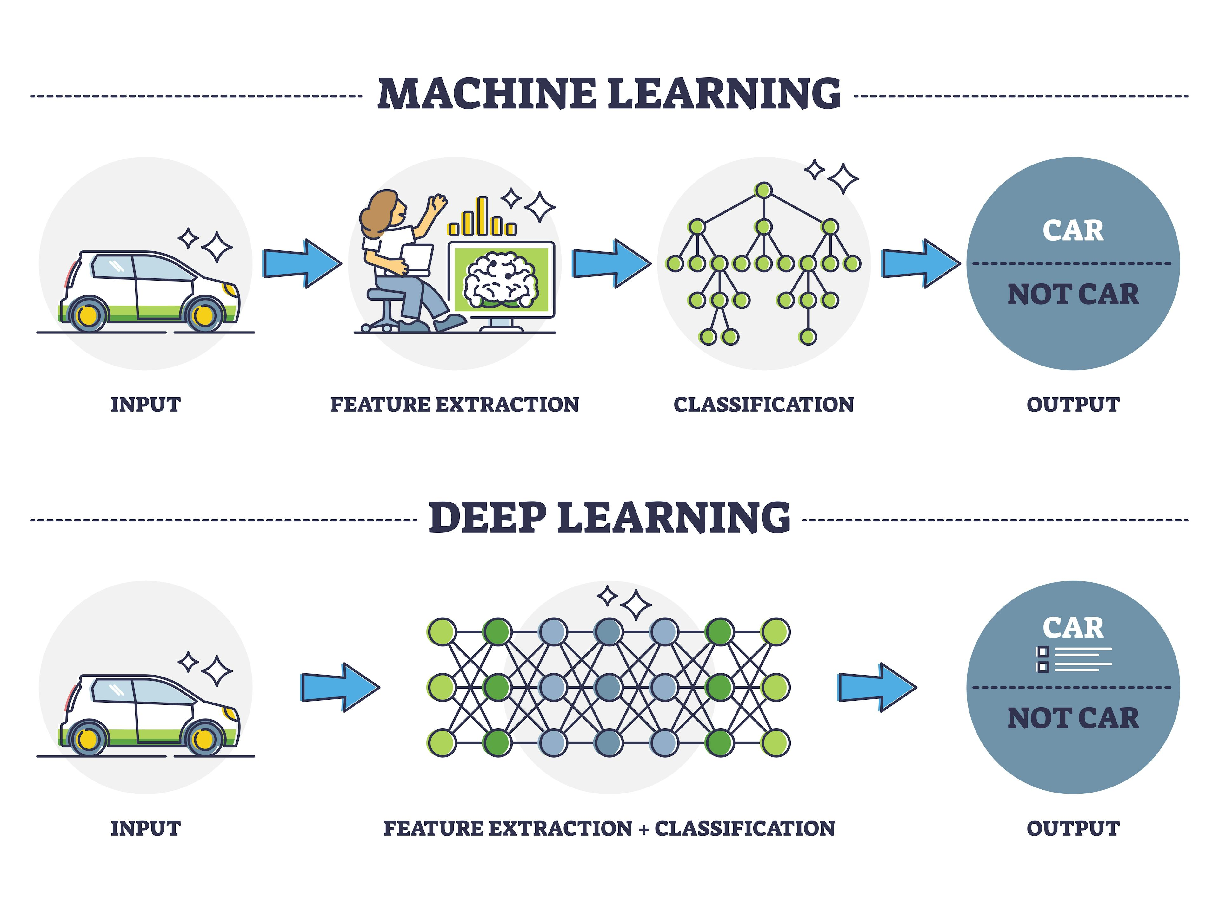
Deep learning
Deep learning, on the other hand, is a subfield of machine learning dealing with algorithms based essentially on multi-layered artificial neural networks (ANN) that are inspired by the structure of the human brain.

Slide 7
Reference
(DataCamp. (n.d.). What is Machine Learning? Retrieved from https://www.datacamp.com/blog/what-is-machine-learning)
https://machinelearningmastery.com/how-to-develop-a- convolutional-neural-network-to-classify-photos-of-dogs-and- cats/
https://learn.microsoft.com/en-us/dotnet/machine- learning/tutorials/object-detection-model-builder
https://pytorch.org/tutorials/beginner/blitz/cifar10_tutorial.html

